Slide 1
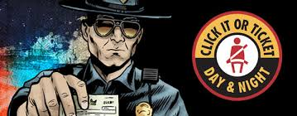
Click It or Ticket
Traffic Safety Training

Slide 2
Click It or Ticket
Traffic Safety Training
Provided By:
Florida Law Enforcement Liaison Program

Slide 3
Click It or Ticket
Traffic Safety Training
This presentation can be used by any law enforcement agency in the Nation. The information provided has been taken directly from the NHTSA Traffic safety marketing website.
We have created this presentation in an effort to assist agencies in conducting occupant protection training with all department personnel. Feel free to edit as needed to meet your agencies needs.
Slides 23 – 26 are Florida specific listing State Statutes. Feel Free to update to your states statutes.

Slide 4
Click It or Ticket
Traffic Safety Training
Click It or Ticket Mobilization
Social Media
NHTSA Educational Material
Earned Media
Completing the CIOT enforcement wave report
Florida Specific Seat Belt Statutes

Slide 5
Click It or Ticket
Click It or Ticket Mobilization
NHTSA has provided the following information can be downloaded and used to educate your agencies personnel as well as the public about the importance of occupant protection. This information can be found at NHTSA Traffic Safety Marketing.gov:
trafficsafetymarketing.gov/ciot
Available Materials:
Banner Ads, Earned Media, Flyers, Logos, Posters,
Radio Ads, Social Media, TV Ads, and Web Videos

Slide 6
Click It or Ticket
Banner Ads

Slide 7
Click It or Ticket
Earned Media
Use earned media to promote the Click It or Ticket Campaign message. Provided materials include:
Welcome
A Call to Action
Proclamation
Fact Sheet
Press Release

Slide 8
Click It or Ticket Welcome Document

Slide 9
Click It or Ticket Call to Action

Slide 10
Click It or Ticket Fact Sheet

Slide 11
Click It or Ticket Proclamation

Slide 12
Click It or Ticket Press Release

Slide 13
Click It or Ticket
Flyers
Post flyers in department lobby, roll call room, city or county facilities and local businesses.

Slide 14
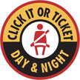
Click It or Ticket
Logos
Use Click It or Ticket logo to promote the campaign message.

Slide 15
Click It or Ticket
Posters
Use 19 different posters to promote the campaign message.

Slide 16
Click It or Ticket
Radio Ads
Use 22 different radio ads to promote the campaign message with local radio stations.

Slide 17
Click It or Ticket
Social Media
Use your departments website and Facebook page (if applicable) to post Click It or Ticket message.

Slide 18
Click It or Ticket
TV Ads

Slide 19
Click It or Ticket
Wed Videos

Slide 20
Click It or Ticket
Traffic Safety Training Video
Click Link: Is Today Your Day?

Slide 21
Click It or Ticket
Enforcement Report
We need your CIOT report numbers

Slide 22
Click It or Ticket
Enforcement Report
The following information will assist you in compiling the information you will need to complete the Click It or Ticket campaign enforcement report.
There are five sections to the report
Specific Enforcement Activity during this Reporting Period
Enforcement Activity Results
Public Information and Education Activities during this Reporting Period
Earned Media
Safety Belt Usage Survey Results

Slide 23
Click It or Ticket
Enforcement Report
Specific Enforcement Activity during this Reporting Period
Enter the approximate total officer hours worked during the enforcement period on safety belt enforcement for each area requested.
Approximate hours of routine Safety Belt Enforcement
Approximate hours of Safety Belt Enforcement Operations
Approximate hours of Child Restraint Enforcement Operations
Approximate hours of safety belt enforcement worked as OT
Approximate hours of safety belt enforcement between
8:00 PM and 6:00 AM

Slide 24
Click It or Ticket
Enforcement Report
Enforcement Activity Results
Enter the number of activities for each of the listed areas requested.
Safety Belt Citations Suspended Licenses
DUI Arrests Uninsured Motorists
Felony Arrests Speeding Citations
Child Safety Seat Citations Reckless Driving
Recovered Stolen Vehicles Drug Arrests
Fugitives Apprehended Other Arrests

Slide 25
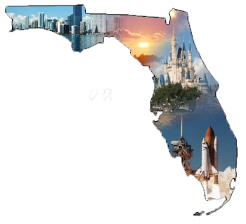
Click It or Ticket
Enforcement Report
Agency’s Top Producer for campaign*
Enter the name and rank of your agency’s top producer and the number of safety belt citations they wrote during this campaign.
Officer Name and rank:
Number of Safety Belt Violations:
*Florida Specific

Slide 26
Click It or Ticket
Enforcement Report
Public Information and Education Activities during Reporting Period
Activities which agency conducted and or participated in which are likely to bring about public awareness regarding safety belt use and or child restraint use - Enter Yes or No
Media release
Child seat fitting event
Child seat giveaways
Use of NHTSA planner materials
Use of variable message boards, banners, posters etc…
Other (explain)
Number of Press Conferences hosted promoting the CIOT

Slide 27
Click It or Ticket
Enforcement Report
Earned Media
Media is earned when an agency conducts or participates in an activity or event which generates media attention and reporting. Agencies must track earned media reports and check all that apply. Examples of Social network systems media are Facebook, MySpace and Twitter.
Enter a number for each area of media the agency earned during or prior to this campaign. Enter the number of online page views, shares, hits, forwards and or tweets from social network media
Number of TV media reports through Agency press release or agency activity
Number of radio media reports through Agency press release or agency activity
Number of print media reports through Agency press release or agency activity
Total number of hits, views, tweets, shares or forwards from agency’s use of social network systems media or through agency’s press release or agency’s activity

Slide 28
Click It or Ticket
Enforcement Report
Safety Belt Usage Survey Results
Enter the results from your agency’s safety belt usage surveys prior to and after the campaign:
Safety Belt usage rate prior to current wave
Safety Belt usage rate after current wave

Slide 29
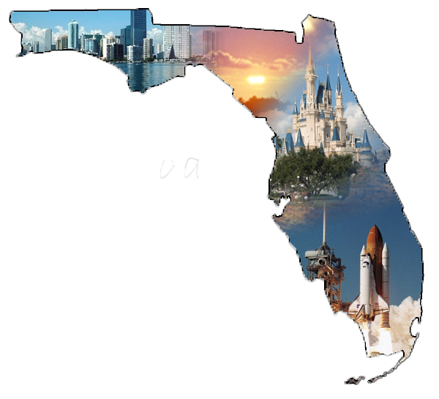
Click It or Ticket
Use of Seat Belts by Personnel:
All persons who operate or are passengers in an
agency owned vehicle shall wear the seat belts as
required by state law in F.S.S. 316.14 Seat belt Usage.

Slide 30
Click It or Ticket
SEAT BELT ENFORCEMENT:
Seat Belt Enforcement is a priority and shall be
enforced by all agency personnel.
Properly used safety belts and child safety seats are proven
effective measures for reducing fatalities and serious
injuries. The Department will participate in Click It or Ticket
enforcement mobilizations in an effort to reduce the number
of occupant protection related fatalities and injury crashes
on our roadways.

Slide 31
Click It or Ticket
Occupant Protection Violations:
Child Restraint – Primary Violation
F.S.S. 316.613(1)(a)
Any child 5 years of age or younger must be secured in a
child restraint device.
*Florida Specific

Slide 32
Click It or Ticket
Occupant Protection Violations:
Seat Belt (Driver) – Primary Violation
F.S.S. 316.614(4)(b)
It is unlawful for any person to operate a motor vehicle in this state unless the person is restrained by a seat belt.
*Florida Specific

Slide 33
Click It or Ticket
Occupant Protection Violations:
Seat Belt (Front Passenger) – F.S.S. 316.614(5)
(citation goes to the passenger)
It is unlawful for any person 18 or older to be a passenger in the front seat of a motor vehicle unless such person is restrained by a seat belt.
*Florida Specific

Slide 34
Click It or Ticket
D.U.I. Violations:
Impaired Driving Violations can be found under F.S.S. 316.193
You will be required to review your statutes for specific infraction.
*Florida Specific

Slide 35
Click It or Ticket
Verbal Judo:
The following statement should be made on all traffic stops. Keep in mind that we must be professional and courteous at all times as representatives of our Department.

Slide 36
Click It or Ticket
Statement
Hello, My name is Officer/Deputy _______, with the ________Police/Sheriff’s Department. May I see your Driver’s License, Vehicle Registration, and Insurance? The reason I stopped you today is because (unlawful speed, ran red light, ect.). Is there any justifiable reason why you (committed said violation)? Allow the driver to respond.

Slide 37
Click It or Ticket
Closing Statement
It is our responsibility as traffic safety professionals to
educate the public and our fellow officers of the
deadly consequences of not wearing a seat belt. Lead
by example, conduct training, hand out flyers, post
banners, use social media and of course:
Click It or Ticket!

Slide 38
Law Enforcement Liaison Program
www.floridalel.info

