Slide 1
2017 Florida Law Enforcement Liaison Traffic Safety Challenge
Sandy Richardson
Regional Program Manager
NHTSA Region 4

Slide 2
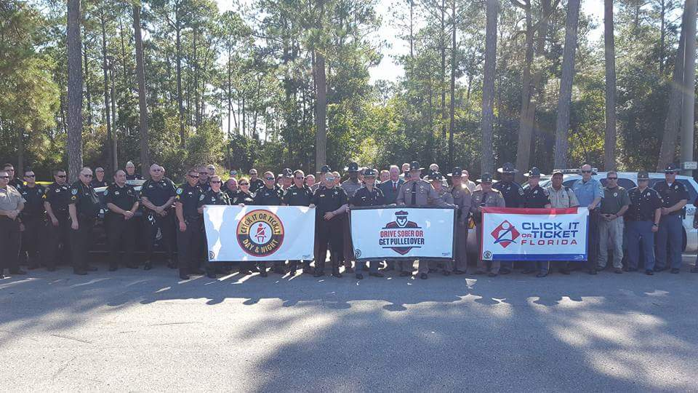
We are here to celebrate your accomplishments
Notes:
The Florida Law Enforcement Liaison Traffic Safety Challenge recognizes the best overall traffic safety programs in Florida. The areas of concentration include efforts to enforce traffic safety laws and educate the public about distracted and impaired driving, motorcycle safety, occupant protection and child passenger safety, pedestrian and bicycle safety, speed and aggressive driving, and other issues that impact the safety of roadway users. This challenge supports the goal of encouraging increased statewide enforcement of traffic safety laws to reduce traffic crashes, serious injuries, and fatalities.

Slide 3
Seat Belt Use is on the Rise in Florida….
Notes:
You are so close to that 90 percent usage rate.

Slide 4
CIOT 2016 v 2015 results
 | National wave 2016 | National wave 2015
Safety Belt Citations | 25001 | 29257
Child Safety Seat Citations | 826 | 856
Reckless Driving | 748 | 773
Speeding Citations | 29667 | 34265
DUI Arrests | 1526 | 1522
Notes:
There has been some slight activity drop off but you have held your own. (2017 data is still being tabulated)

Slide 5
Notes:
Wearing your seat belt remains the single most effective method to prevent ejections and injuries of motorists. In the U.S. alone, 35% of officers killed in vehicle crashes were not buckled up.

Slide 6
August 15 – September 4, 2017
Notes:
The Drive Sober or Get Pulled Over Enforcement Period is starting soon. As always we need your help in removing the impaired drivers from the roadways. .

Slide 7
Drive Sober or Get Pulled Over Data Winter Campaign National DRE Results (December 18, 2016 – January 3, 2017)
37 Reporting States
7,550 DRE DUI Arrests
1,333 DRE DUI Drug Arrests
403 DRE-Involved Sobriety Checkpoints
1,643 DRE-Involved Emphasis Patrols
3,338 Drug Arrests

Slide 8
Out making a difference…

Slide 9
Preliminary Data July 2, 2016 Compared to July 2, 2017
2016 1,616
2017 1,612

Slide 10
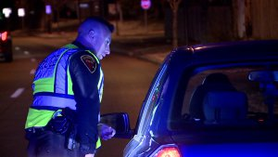
It is dangerous out there take precautions…
Buckle Up
Be careful of distractions
Be safe and seen when you pull someone over

Slide 11
Even on ice, you are getting noticed…

Slide 12
You have seen it all…
There are people that put their lives in harms way everyday.
It is not something they do,
It is something they are.
No matter the call you run forward…
Thank you
Notes:
You folks in Florida take the statement - everyone is a pedestrian sometime - you really mean it.

Slide 13
Thank you for all that you do You make a difference

